Slide 1
Dockers

Slide 2
What is a Container?
Containers are fundamentally changing the way we develop, distribute, and run software.
Developers can build software locally, knowing that it will run identically regardless of host environment—be it a rack in the IT department, a user’s laptop, or a cluster in the cloud.
Operations engineers can concentrate on networking, resources, and uptime and spend less time configuring environments and battling system dependencies.
The use and uptake of containers is increasing at a phenomenal rate across the industry, from the smallest start ups to large-scale enterprises.
Developers and operations engineers should expect to regularly use containers in some fashion within the next few years.
Containers are an encapsulation of an application with its dependencies.
At first glance, they appear to be just a lightweight form of virtual machines (VMs)—like a VM, a container holds an isolated instance of an operating system (OS), which we can use to run applications.

Slide 3

Containers share resources with the host OS, which makes them an order of magnitude more efficient.
Containers can be started and stopped in a fraction of a second.
Applications running in containers incur little to no overhead compared to applications running natively on the host OS.
The portability of containers has the potential to eliminate a whole class of bugs caused by subtle changes in the running environment—it could even put an end to the age-old developer refrain of “but it works on my machine!”
The lightweight nature of containers means developers can run dozens of containers at the same time, making it possible to emulate a production ready .

Slide 4

The diagram depicts a type 2 hypervisor, such as Virtual box or VMWare Workstation, which runs on top of a host OS. Type 1 hypervisors, such as Xen, are also available where the hypervisor runs directly on top of the bare metal.
The kernel is the core component in an OS and is responsible for providing applications with essential system functions related to memory, CPU, and device access.
A full OS consists of the kernel plus various system programs, such as in it systems, compilers, and window managers. tributed system.
Operations engineers can run many more containers on a single host machine than using VMs alone.
Containers also have advantages for end users and developers outside of deploying to the cloud.
Users can download and run complex applications without needing to spend hours on configuration and installation issues or worrying about the changes required more importantly, the fundamental goals of VMs and containers are different—the purpose of a VM is to fully emulate a foreign environment, while the purpose of a container is to make applications portable and self-contained to their system.
In turn, the developers of such applications can avoid worrying about differences in user environments and the avail‐ ability of dependencies.

Slide 5
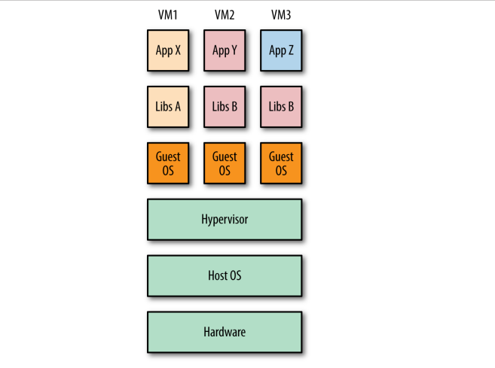
Three VMs running on a single host

Slide 6
Containers VS VMs
Though containers and VMs seem similar at first, there are some important differences, which are easiest to explain using diagrams.
Shows three applications running in separate VMs on a host. The hypervisor1 is required to create and run VMs, controlling access to the underlying OS and hardware as well as interpreting system calls when necessary.
Each VM requires a full copy of the OS, the application being run, and any supporting libraries. In contrast, shows how the same three applications could be run in a containerized system.
Unlike VMs, the host’s kernel2 is shared with the running containers.

Slide 7

This means that containers are always constrained to running the same kernel as the host. Applications Y and Z use the same libraries and can share this data rather than having redundant copies.
The container engine is responsible for starting and stopping containers in a similar way to the hypervisor on a VM. However, processes running inside containers are equivalent to native processes on the host and do not incur the overheads associated with hypervisor execution.
Both VMs and containers can be used to isolate applications from other applications running on the same host. VMs have an added degree of isolation from the hypervisor and are a trusted and battle-hardened technology.
Containers are comparatively new, and many organizations are hesitant to completely trust the isolation features of containers before they have a proven track record.

Slide 8
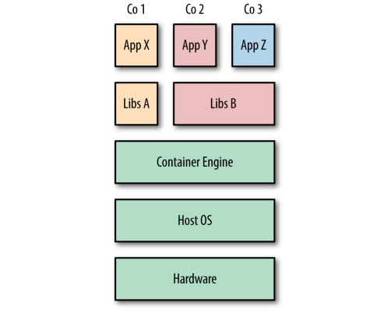
Three containers running on a single host

Slide 9
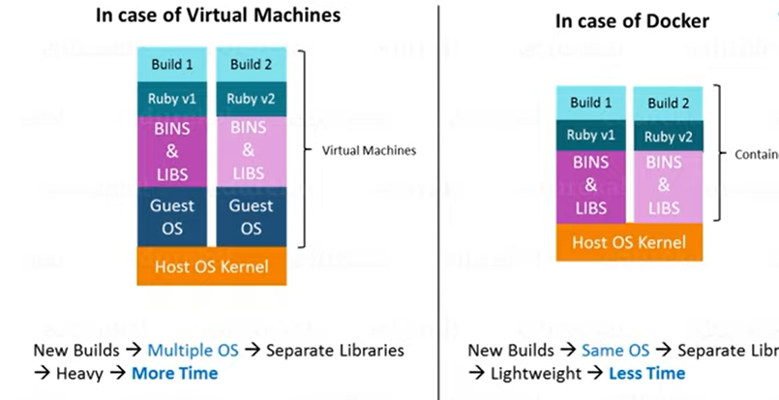

Slide 10
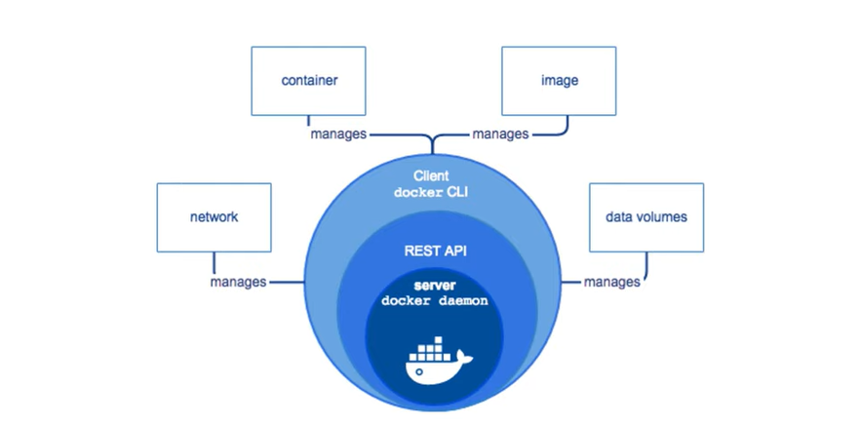
Docker Engine

Slide 11
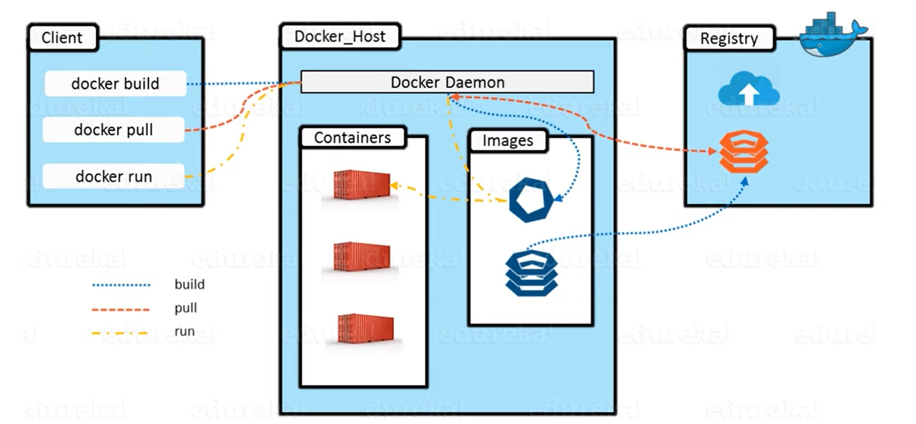
Docker Architecture

Slide 12
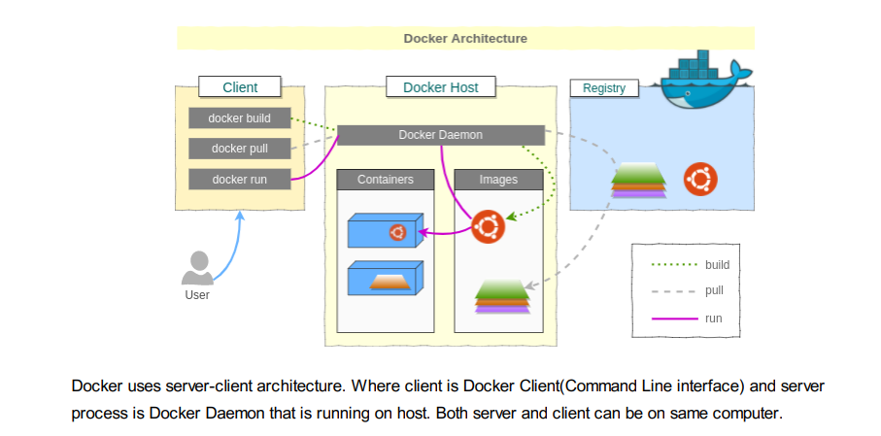
Docker Architecture

Slide 13
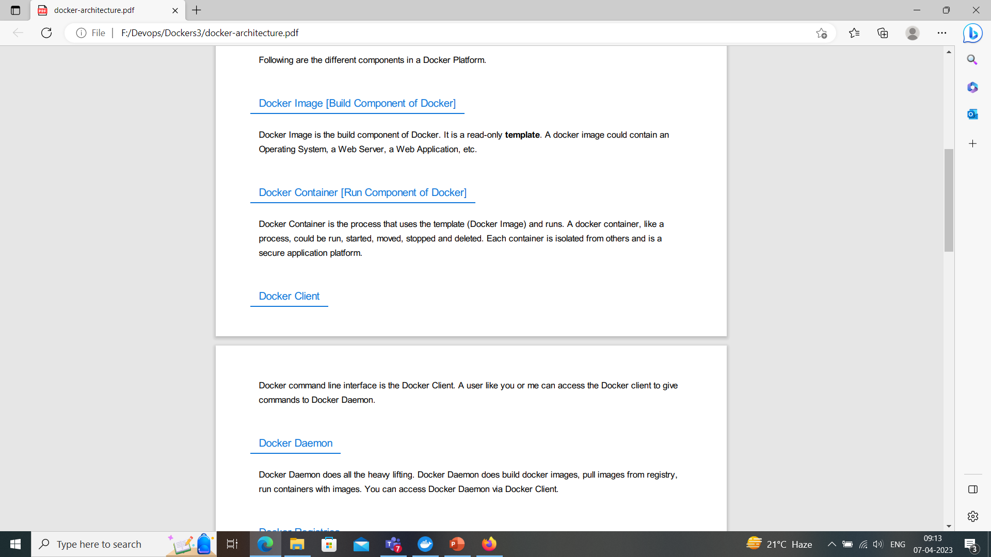

Slide 14
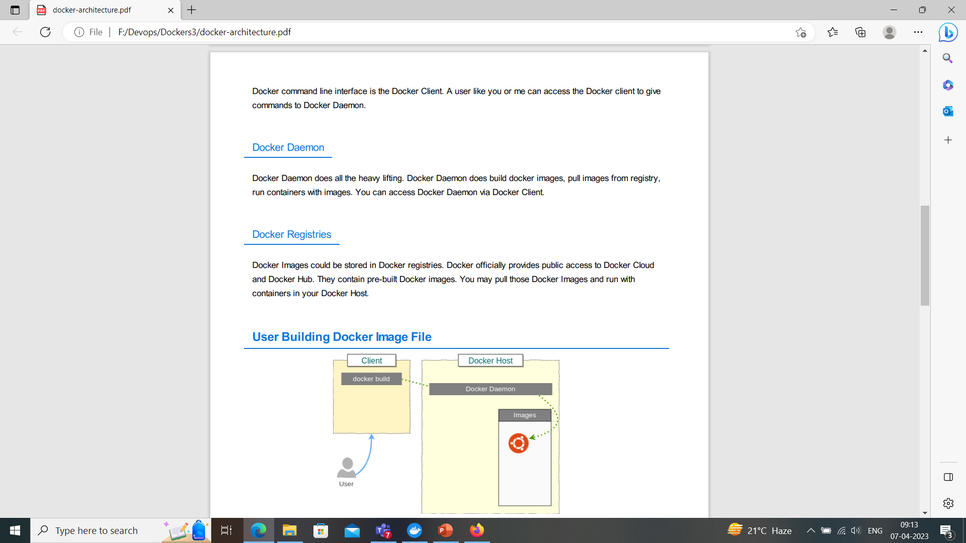

Slide 15
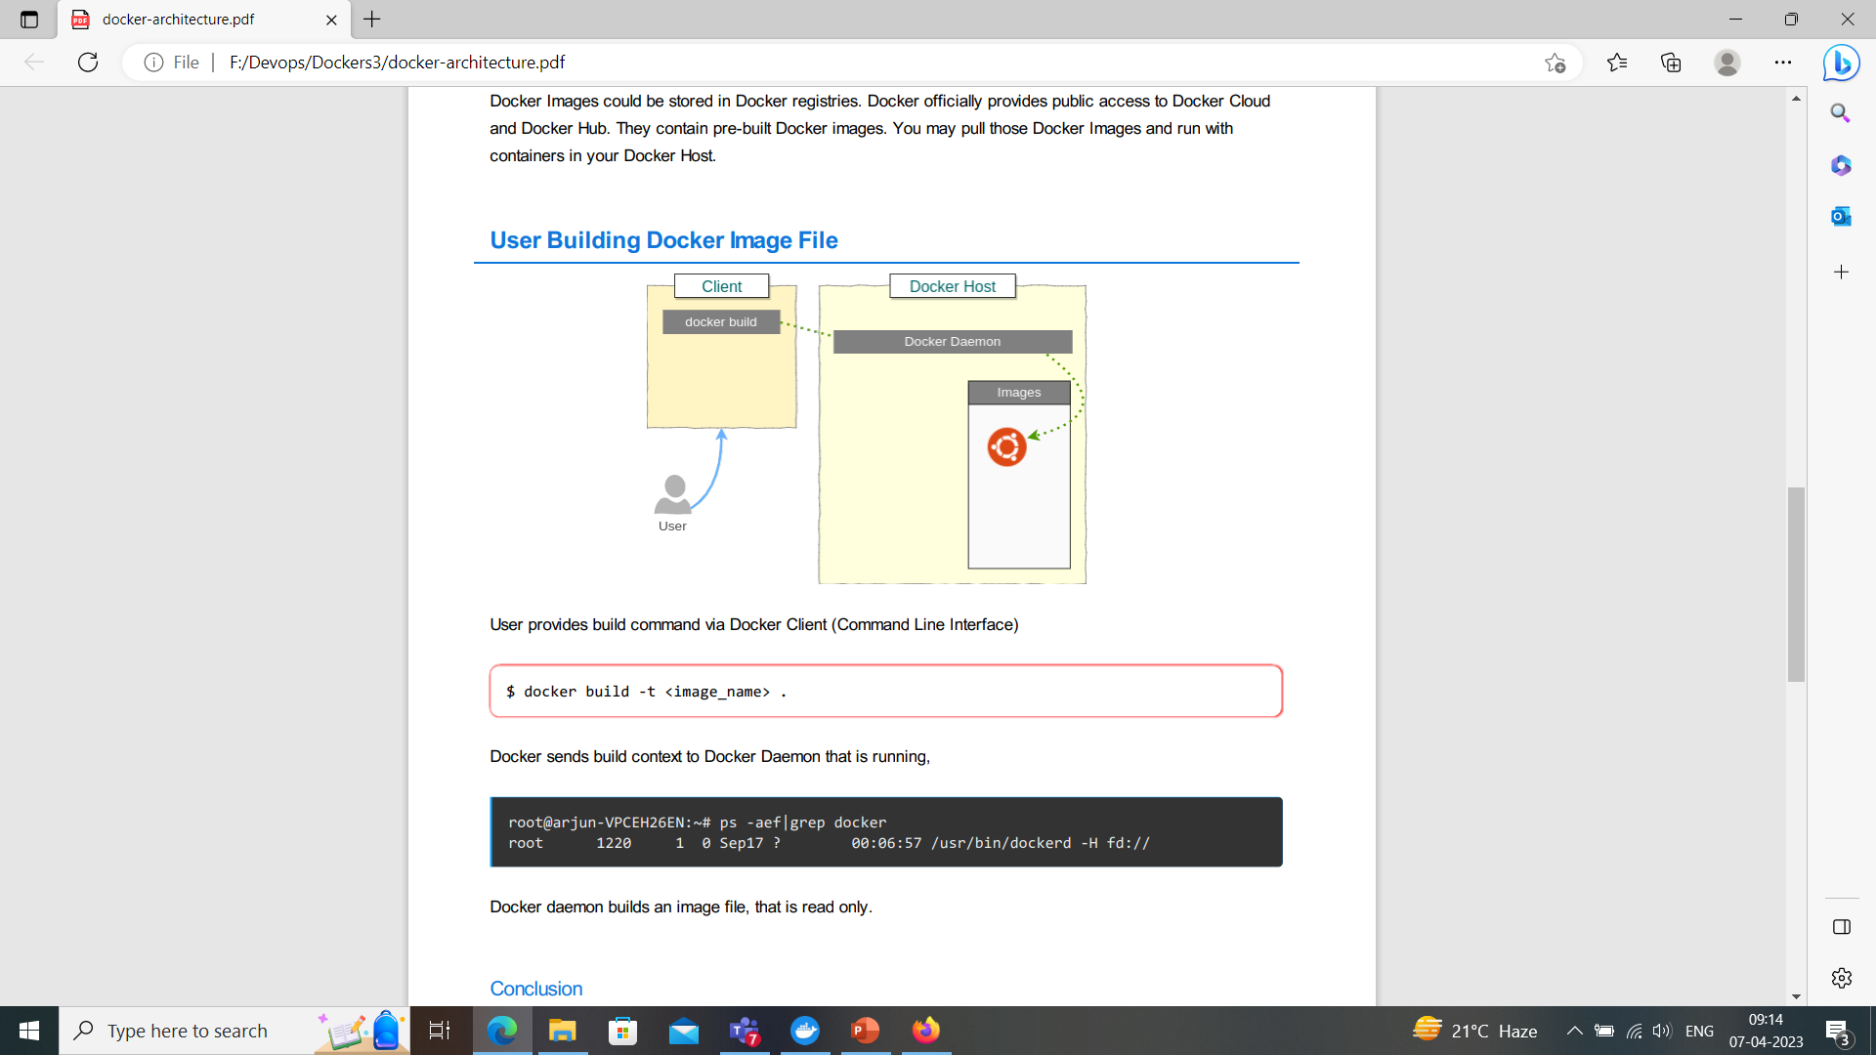

Slide 16
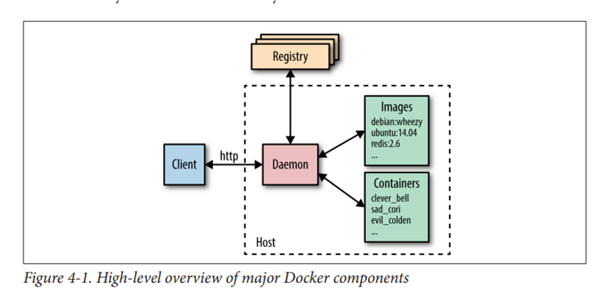
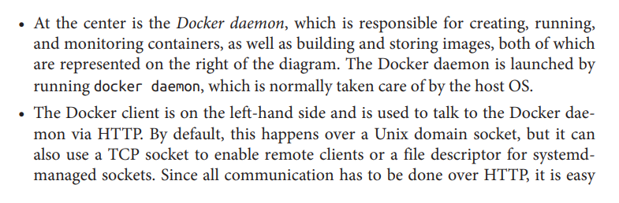
Major Docker Components

Slide 17

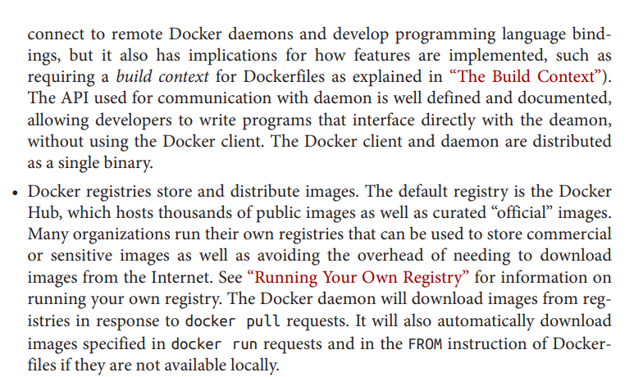
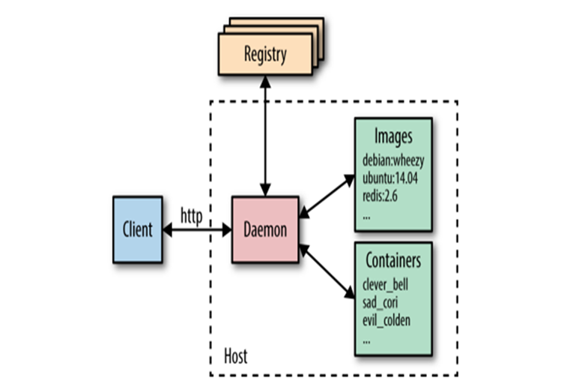

Slide 18
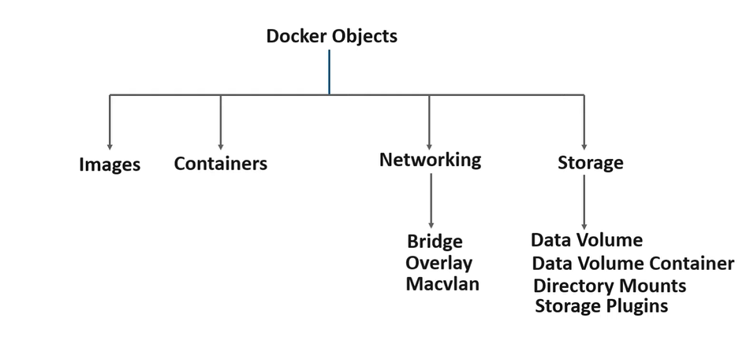
Docker Objects

Slide 19
What is a kernel?
The kernel is the essential foundation of a computer's operating system (OS).
It is the core that provides basic services for all other parts of the OS.
It is the main layer between the OS and underlying computer hardware, and it helps with tasks such as process and memory management, file systems, device control and networking.
During normal system startup, a computer's basic input/output system, or BIOS, completes a hardware bootstrap or initialization.
It then runs a bootloader which loads the kernel from a storage device such as a hard drive into a protected memory space. Once the kernel is loaded into computer memory, the BIOS transfers control to the kernel.
It then loads other OS components to complete the system startup and make control available to users through a desktop or other user interface.
If the kernel is damaged or cannot load successfully, the computer will be unable to start completely if at all.
This will require service to correct hardware damage or restore the operating system kernel to a working version.

Slide 20
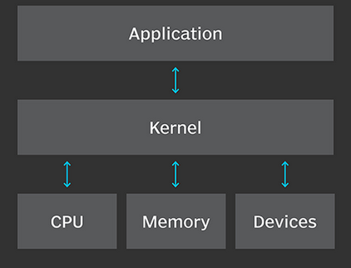
Kernel : Bridge between OS and Application

Slide 21
What is the purpose of the kernel?
In broad terms, an OS kernel performs three primary jobs.
It provides the interfaces needed for users and applications to interact with the computer.
It launches and manages applications.
It manages the underlying system hardware devices.
In more granular terms, accomplishing these three kernel functions involves a range of computer tasks, including the following:
loading and managing less-critical OS components, such as device drivers;
organizing and managing threads and the various processes spawned by running applications;

Slide 22
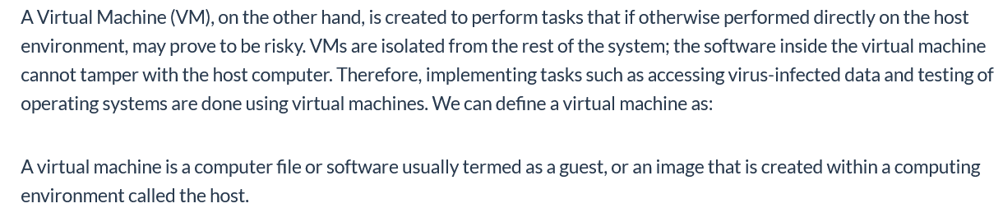
What is a Virtual Machine?

Slide 23

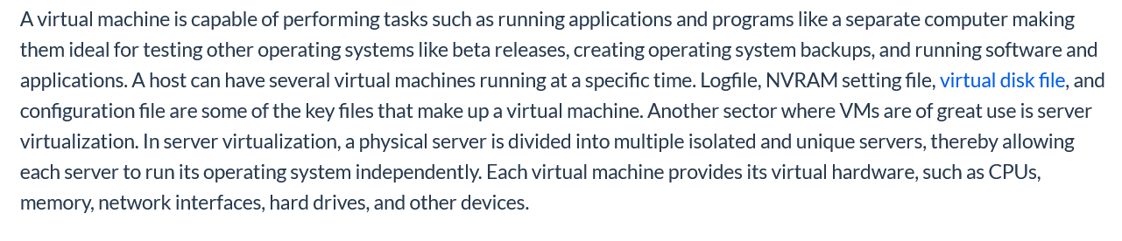

Slide 24
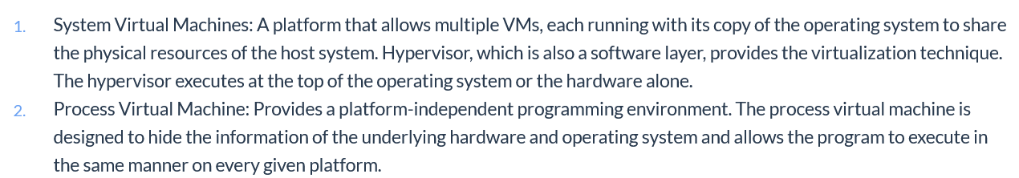
Types of VM

Slide 25
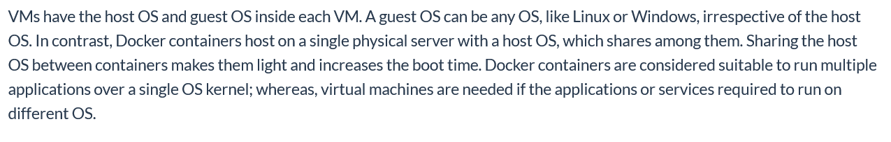
Key Feature of Interest

Slide 26

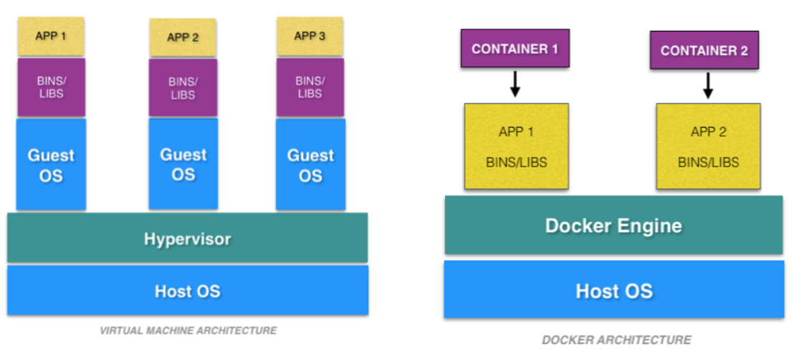

Slide 27
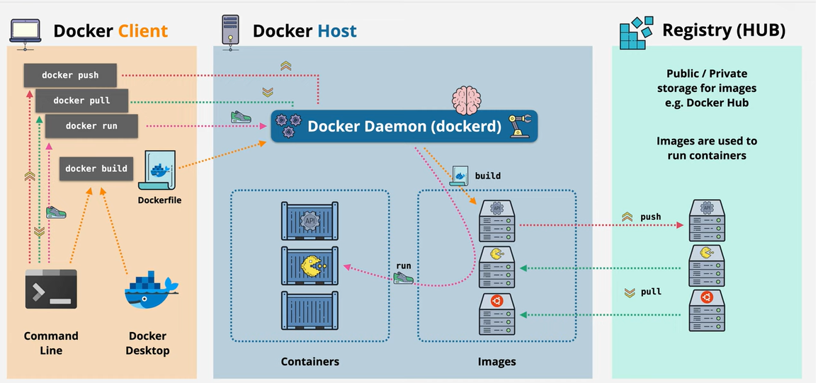
Docker : Work Flow

Slide 28
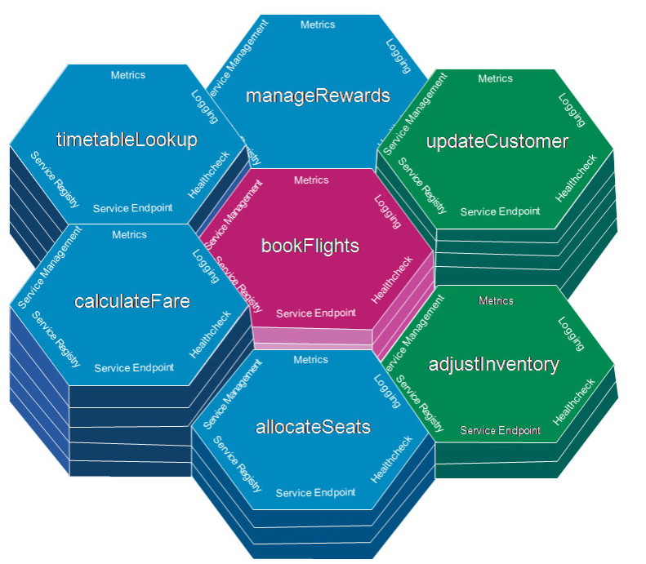
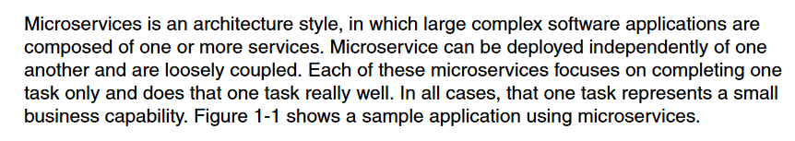
Microservices

Slide 29
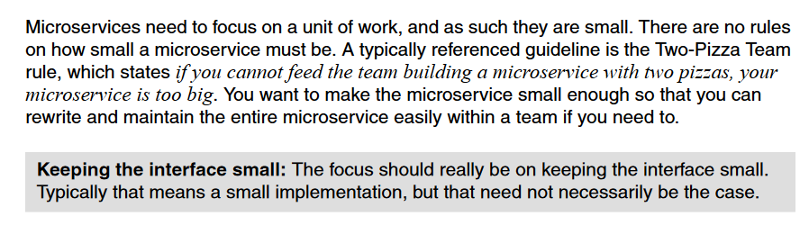
Focus :Unit Of Work

Slide 30
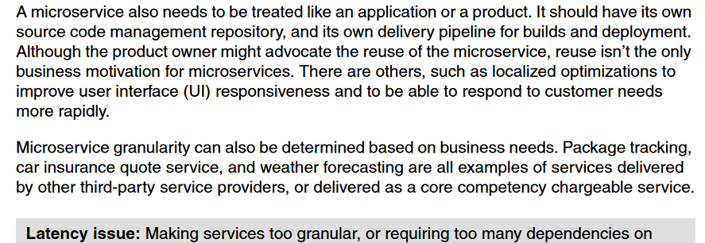
Microservices :SCM

Slide 31
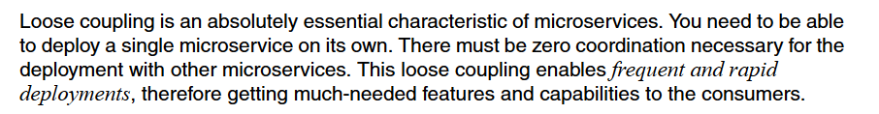
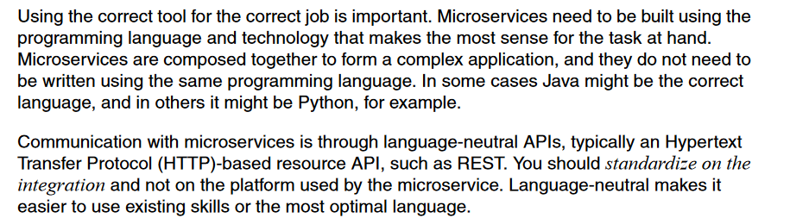
Microservices : Loose Coupling

Slide 32
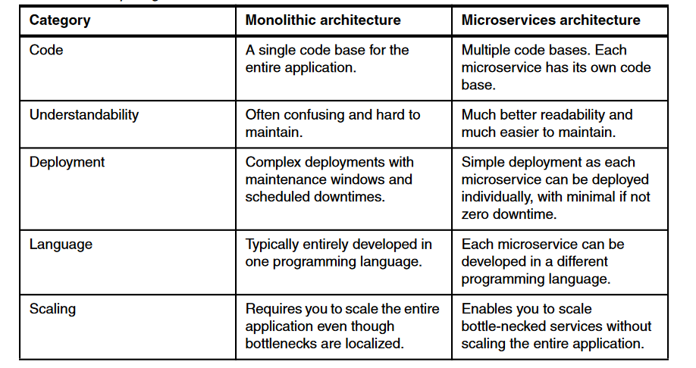
Difference : Monolithic & Microservices

Slide 33
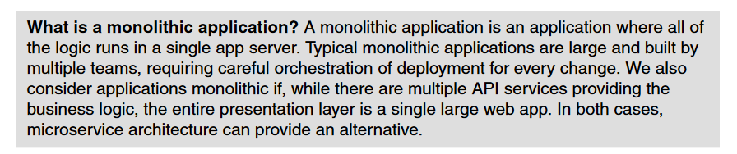
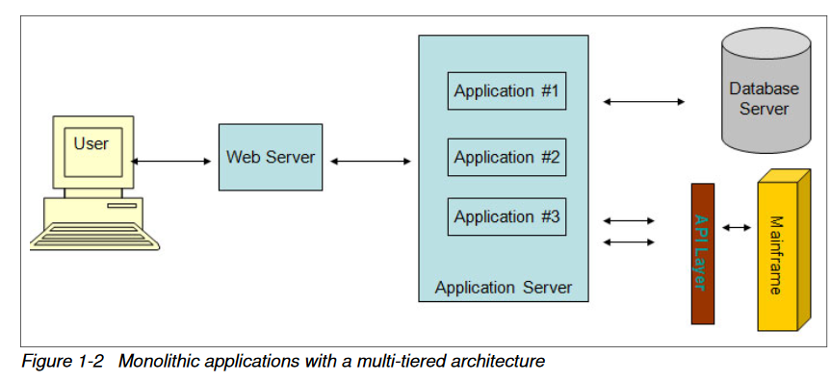
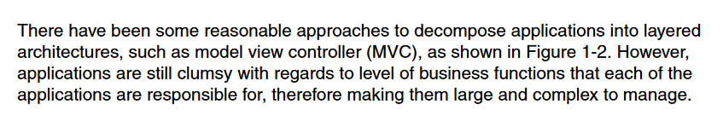
Monolithic Architecture

Slide 34
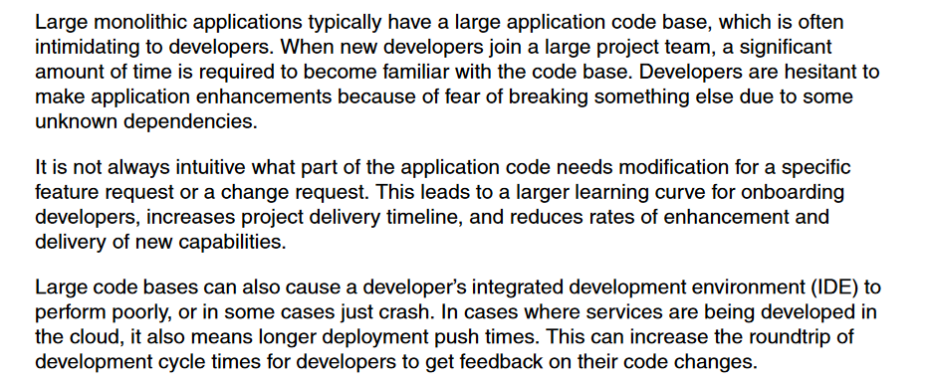
Issues With Monolithic Applications

Slide 35
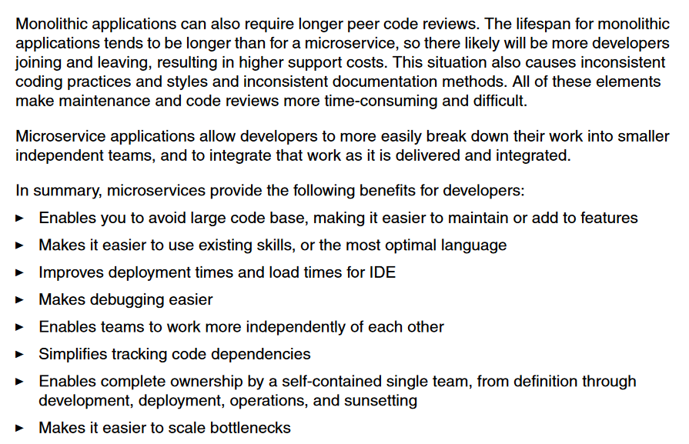

Slide 36
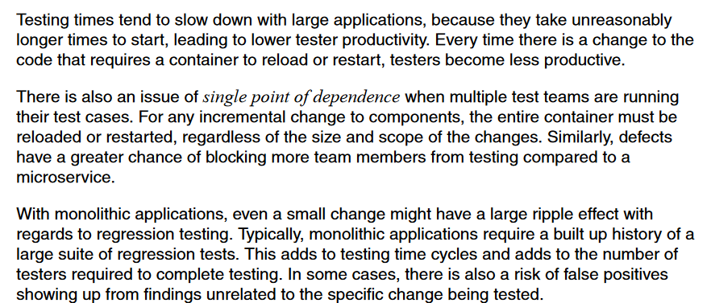
Testing With Monolithic Applications

Slide 37
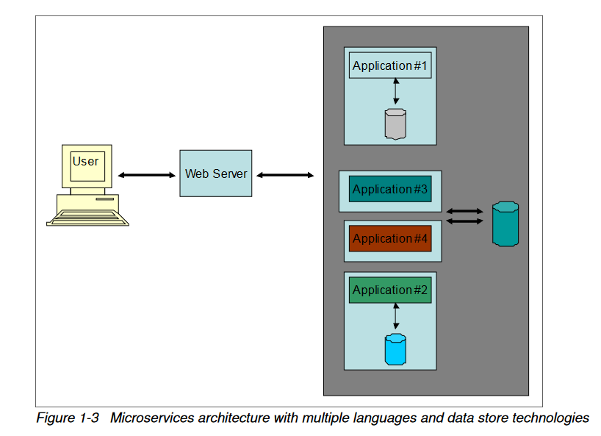
Microservice Architecture with multiple data store and languages

Slide 38
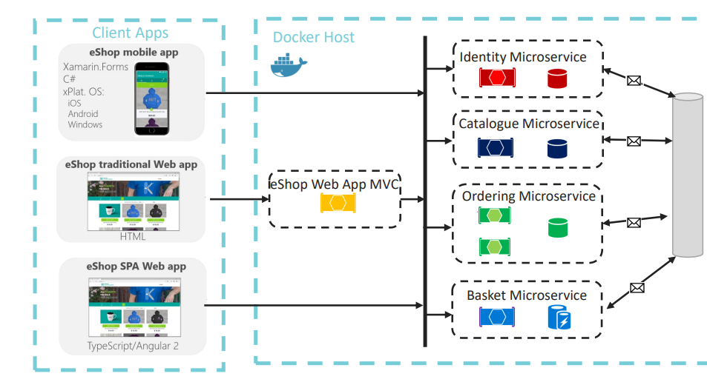
Microservice Scenario

Slide 39
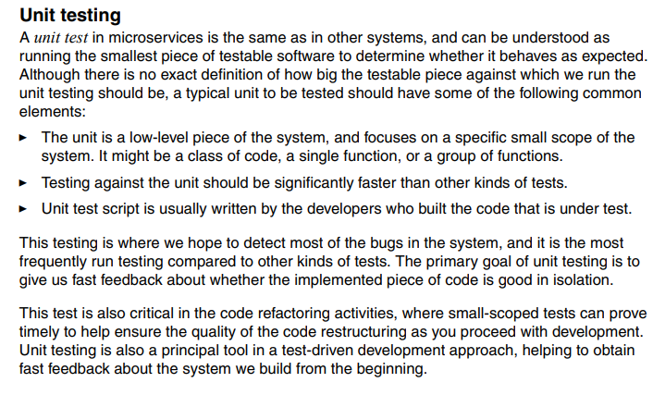
Testing Strategies

Slide 40
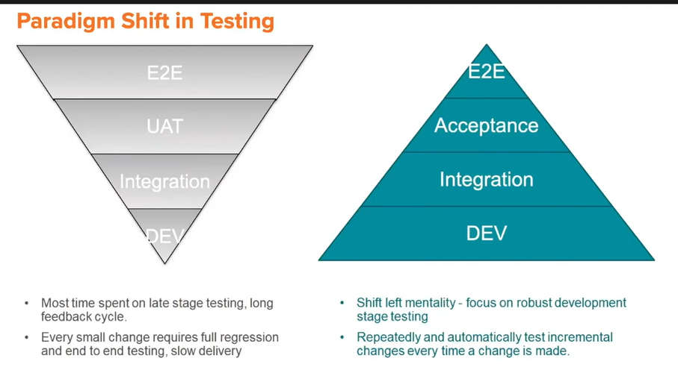

Slide 41
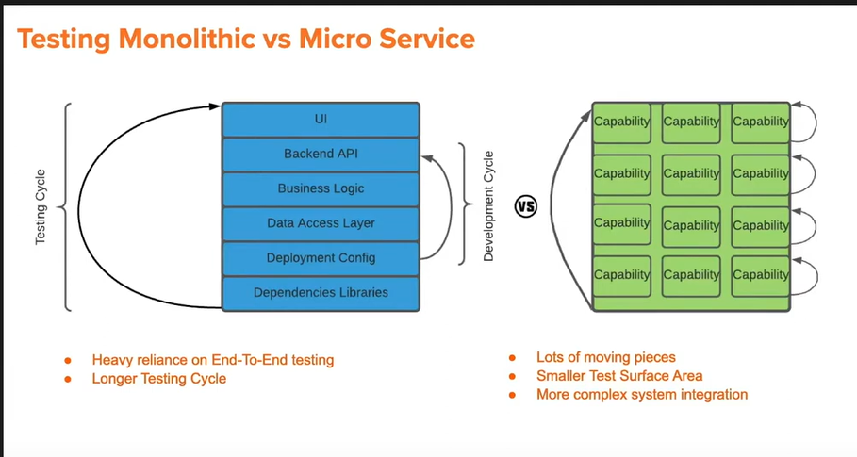

Slide 42
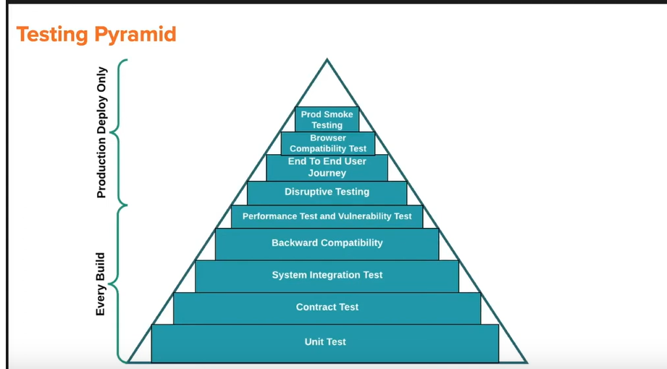

Slide 43
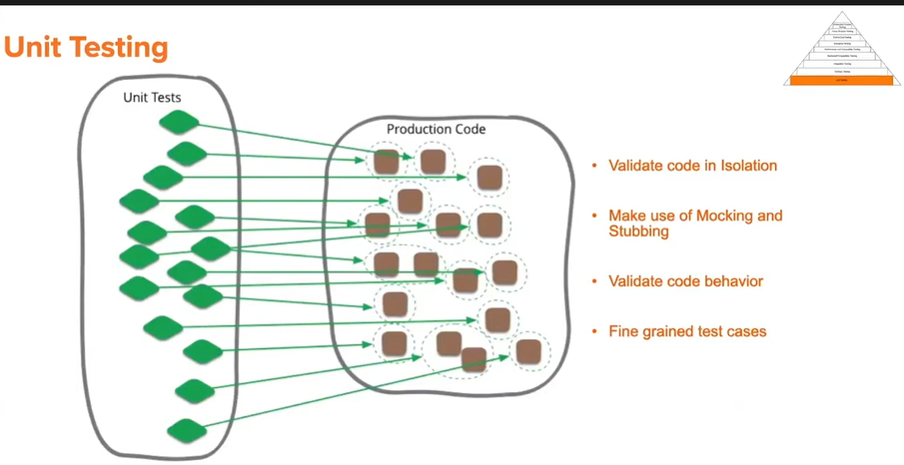

Slide 44
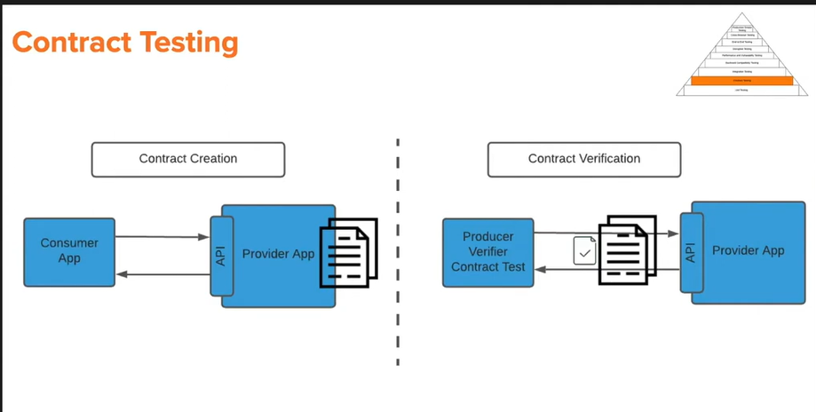

Slide 45
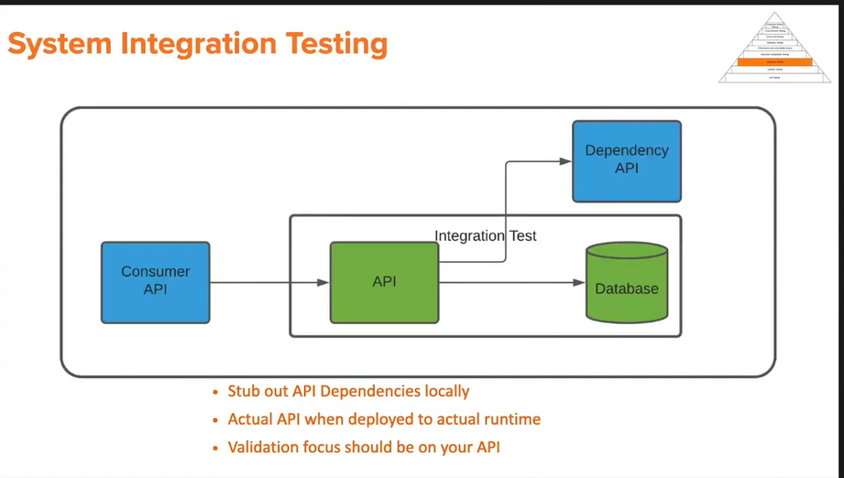

Slide 46
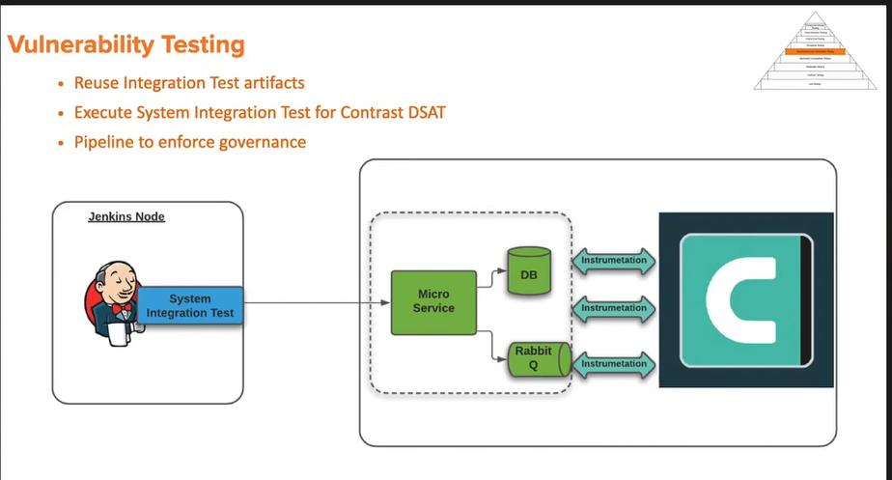

Slide 47
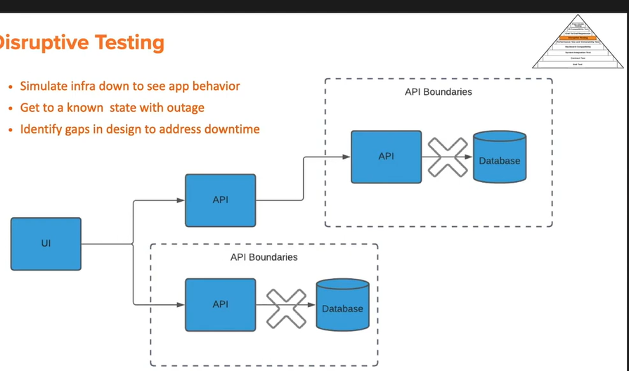

Slide 48
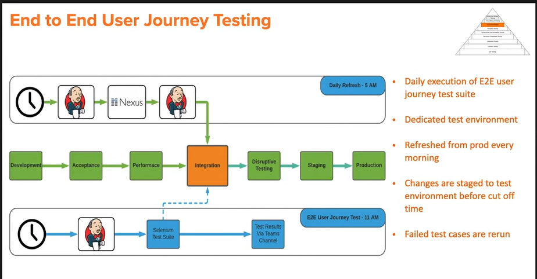

Slide 49
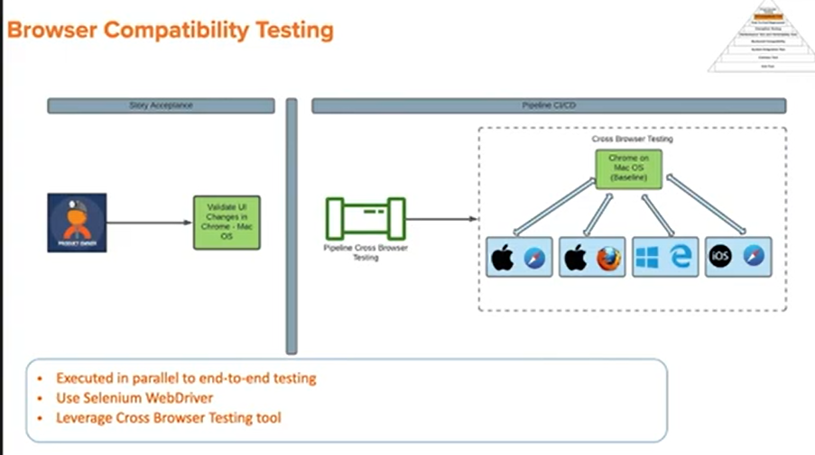

Slide 50

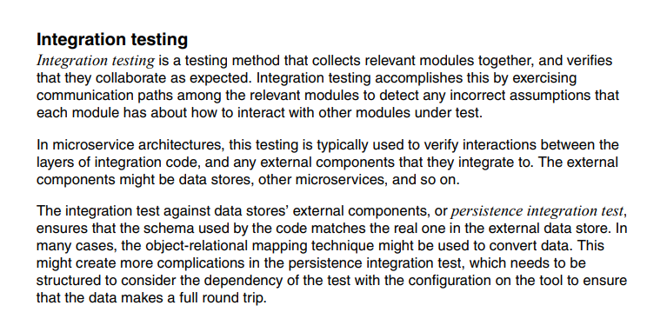

Slide 51

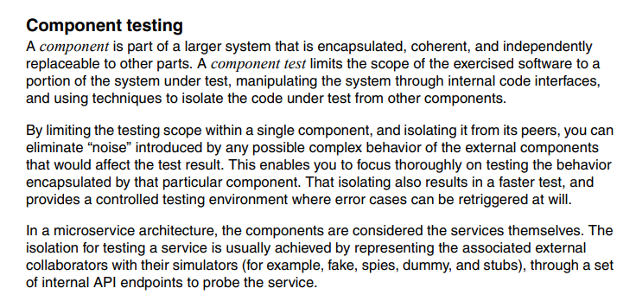

Slide 52

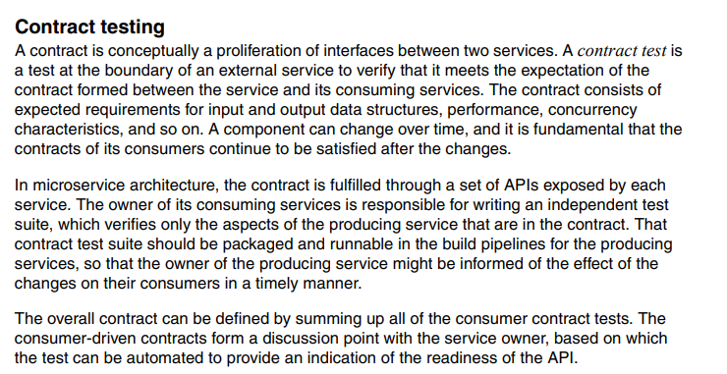

Slide 53



Slide 54



Slide 55


